Slide 1
Golang
Maziar Sojoudian

Slide 2


Golang
Go or Golang was created by Google in November 2009.

Slide 3

Golang
Go programming language, or, in short, Golang, is syntactically similar to C but also has memory safety, garbage collection, structural typing, and CSP-style concurrency.

Slide 4


golang
Golang applications compile to operating system-specific binary executables, resulting in truly blazing runtime speed. Go is highly popular for cloud-based services like Docker and Kubernetes.

Slide 5

golang
Applications you can create using Go:
Command-line applications.
Web-based applications.
System Programs.

Slide 6

golang
Go implements OOP concepts:
Encapsulation with types and structs
Polymorphism with interfaces

Slide 7

golang
Compiled Languages:
C
C++
Go
Interpreted Languages:
Python
JavaScript
PHP

Slide 8

Golang, is compiled or interpreted?
Go is a compiled, statically typed language.
The Go tool can run a file without precompiling
Compiled executables are OS-specific
Compiled apps contain statically linked runtime
No external virtual machine is required

Slide 9


Is go Object Oriented?
Go has some object-oriented features:
You can define custom interfaces.
Custom types can implement one or more interface
Custom types can have member methods
Custom structs (data structures) can have member fields

Slide 10
What go doesn’t support
Types of inheritance (no classes)
Method or operator overloading.
You can’t have one or more than one function in a package
or more than one method in a type that has the same name.
Structured exception handling.
Implicit numeric conversions.

Slide 11
Go Syntax

Slide 12
Essential syntax rules
Go is case-sensitive.
Variable and package names are lowercase and mixed case.
Names of public fields have initial uppercase characters.
The initial uppercase character means the symbol is exported.

Slide 13
Semicolons usually not needed
Lines feed ends a statement; No semicolon is required.
Semicolons are part of the formal language spec
The lexer adds them as needed

Slide 14
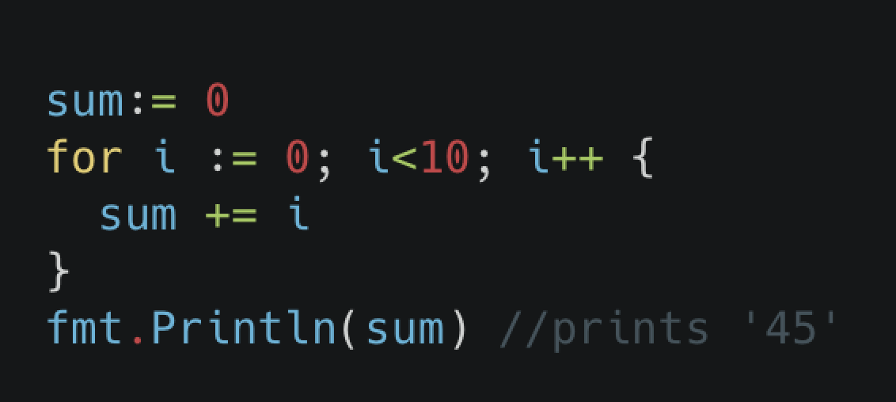
Code blocks with braces
Code blocks are wrapped with braces
Staring brace on the same line as the preceding statement

Slide 15

Built-in functions
Members of built-in package
len(string) - returns the length of a string
panic(error) - stops executing; displays error messages

Slide 16

Install go programming language

Slide 17

Download and install Go
From https://go.dev/dl/ download the appropriate binary for your operating system and install it.

Slide 18

First go application

Slide 19
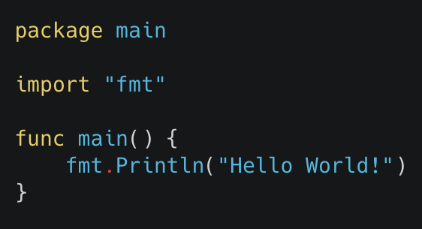
Create hello world application
Access the code via https://github.com/sojoudian/SWtesting/blob/master/w2/helloWorld/main.go

Slide 20
Create hello world application
You have to save this file as main.go
Inside this application we have a main package
Also, we have a main function
A built-in function called format or fmt is imported to print the “Hello world!” statement on the command line

Slide 21
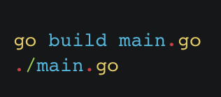
Create hello world application
You can compile the application using the following command:

Slide 22

Variables in go

Slide 23
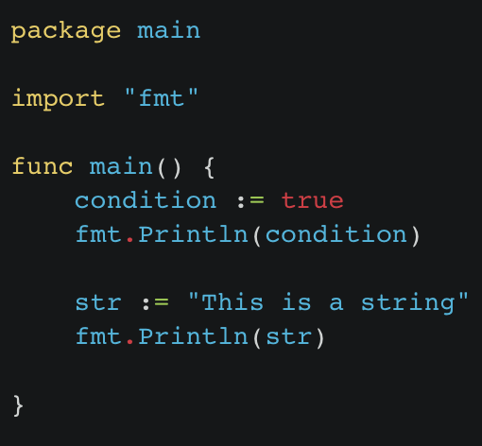
Boolean and string
Boolean values
Bool
TRUE or FALS
String type
string
Access the code via:
https://github.com/sojoudian/SWtesting/blob/master/w2/booleanString/main.go

Slide 24

Integer types
Fixed integer types
uint8 uint16 uint32 uint64
int8 int16 int32 int64

Slide 25
Uint8 vs int8
uint8 and int8 are both data types in the Go programming language, but they represent numbers in different ways:
uint8:
Stands for "unsigned integer 8 bits".
Represents a range of whole numbers from 0 to 255.
Doesn't allow negative values.
It is often used to represent a byte of data, such as in image processing, file I/O, and more.
int8:
Stands for "integer 8 bits".
Represents a range of numbers from -128 to 127.
Allows both negative and positive values.

Slide 26

Float data type
Float values
float32 float64
Complex numbers
complex64 complex128

Slide 27

complex data type
Language organization
Functions
Interfaces
Channels
Data collections
Arrays
Slices
Maps
Structs
Data management
Pointers

Slide 28
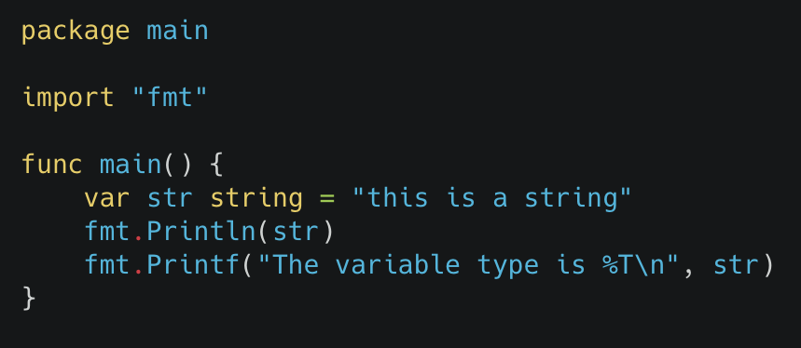
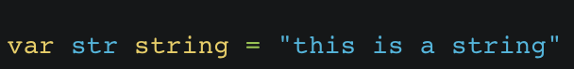
Declare and initialize variables
Using var key word
By using Printf and %T we can find variable type.
Access the code via:
https://github.com/sojoudian/SWtesting/blob/master/w2/varCreateInVarKey/main.go

Slide 29
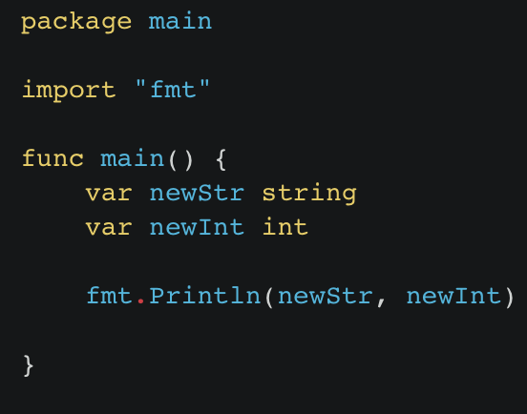
Declare and initialize variables
Each type has it own default value
For int it’s 0
For string its null or ””
Access the code via:
https://github.com/sojoudian/SWtesting/blob/master/w2/intStrDefaultValue/main.go

Slide 30
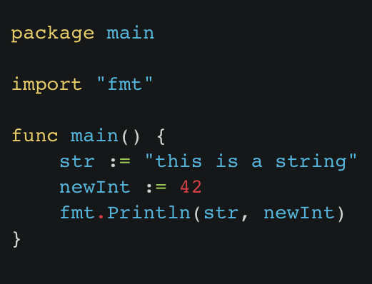
Initialize variables using colon equal
Use “:=” to create and initialize a variable
Access the code via:
https://github.com/sojoudian/SWtesting/blob/master/w2/colonEqualVarInit/main.go

Slide 31
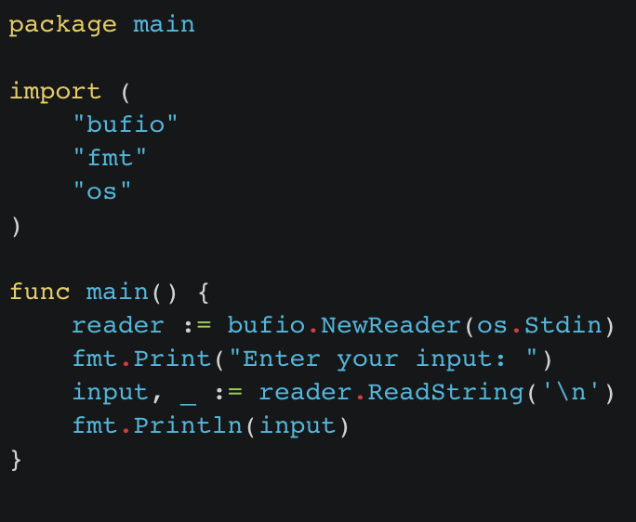
Get input from user
By using bufio and os package you can read users input from the command line
Access the code via:
https://github.com/sojoudian/SWtesting/blob/master/w2/getInputFromCLI/main.go

Slide 32

MATH

Slide 33
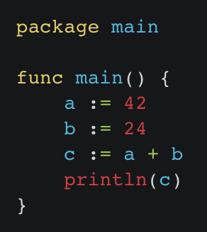
math
+ sum
- subtraction
* multiply
/ division
% reminder
& bitwise AND
| bitwise OR
^ bitwise XOR
&^ bit clear
<< left shit
>> right shift
Access the code via: https://github.com/sojoudian/SWtesting/blob/master/w2/sumMathExmple/main.go

Slide 34
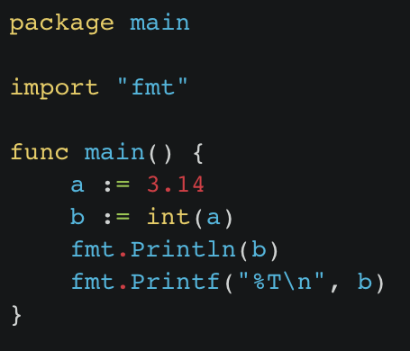
TYPE conversion
Simply by adding the type and set of parenthesis we can convert the current type to the type we want
In the following example the current variable which has float type will be convert to integer by int(b)
Access the code via: https://github.com/sojoudian/SWtesting/blob/master/w2/typeConversion/main.go

Slide 35

Functions in go

Slide 36
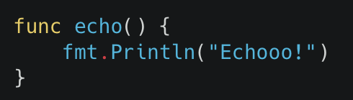
functions
Functions in Go are starting with “func” keyword.
After the keyword func usually is the name of the function. In our example name of the function is ”add”.
After the name of the function is set of parenthesis following with curly brackets
Everything inside curly brackets is called function body curly brackets
!Also, this function is not returning anything!

Slide 37
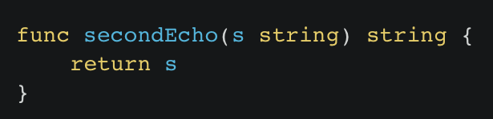
Functions parameters
A function can have multiple parameters, in this example our function called secondEcho and it has parameter called s with data type of string.
This function is also returning data with string data type.
You have to notice that, if you call a function with just a return and not printing you mat not see the result in your command line.

Slide 38
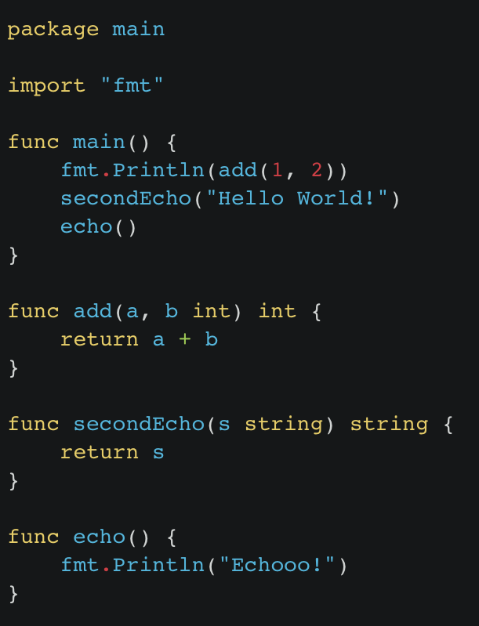
Functions parameters
If we run the following example, we will only see:
3
Echooo!
Because the add function is inside the fmt.Println() function, it will show the result on the CLI
Access the code via: https://github.com/sojoudian/SWtesting/blob/master/w2/funcExample/main.go

